Slide 1

Household Conditions by Geographic School District
Jon Geiger, Noel Goodwin, Abigail Joppa
Week 5

Slide 2
Last Week's Next Steps...
Build regression model to predict graduation rates using HH conditions
Choropleth Maps of graduations rates
Household Income Data?
Meaningful Visualizations

Slide 3
Research Question
One of the only measures being used to predict graduation rates are GPA, tests, disciplinary issues, attendance etc. using a tracking system called EWS (early warning system).
However, we know that household conditions significantly impact these indicators. This leads us to the question:
What household conditions are the biggest indicators for graduation rates across school districts?
How does this differ across:
Racial and ethnic groups?
Regions?
Household income groups?
Notes:
Focused Research Question here

Slide 4
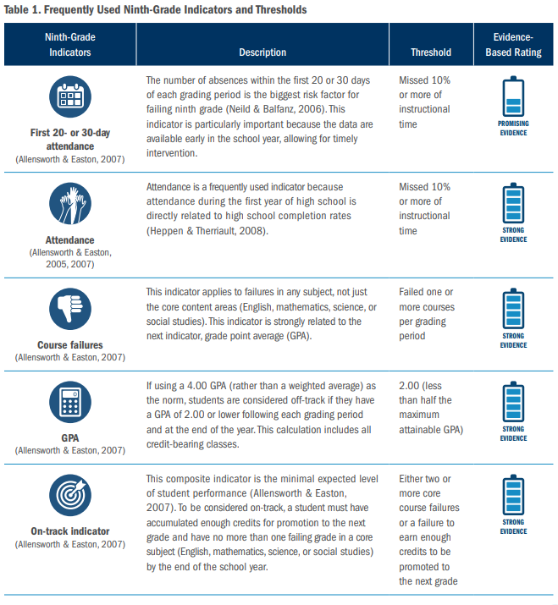
This led us to wonder…
How do the current predictors of graduations rates (GPA, tests, disciplinary issues, attendance, etc.) compare to using household conditions as predictors of graduation rates?
(Research on the top indicators in predicting graduation: https://ccrscenter.org/sites/default/files/EvidenceBasedPractices_EarlyWarningIndicators.pdf)
Notes:
Focused Research Question here

Slide 5
Getting Data for the Current Indicators
Found data by school (not school district) that has the current predictors for graduation rates.
So, we needed a way to be able to join those schools to their respective school districts.
Hence, the work that happened this past week, getting data that can link schools to their school districts.

Slide 6
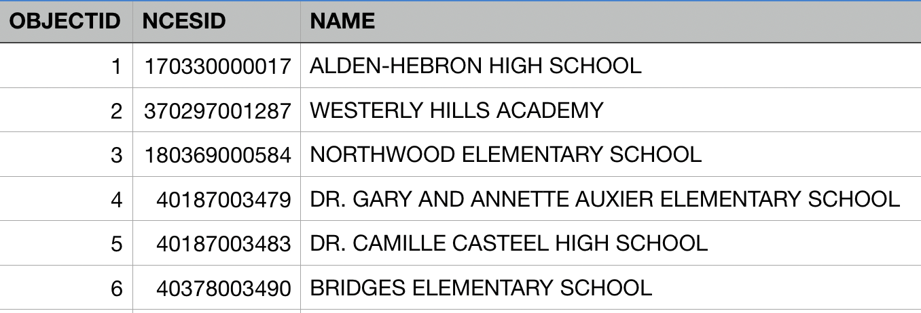
Joining Public School Data with Districts
1) The school data has an NCES ID for each school which includes both the LEA ID (district code) followed by a unique 5-digit school ID
3) Then we filtered the data in order to only include districts with high schools
Filtered to include schools characterized as "HIGH"
OR
Those schools that end in grade 12
2) We separated the NCES ID into the LEA ID and the school ID in order to be able to join by LEA ID which is included in our master data.
Homeland Infrastructure Foundation-Level Data (HIFLD)
305,710 rows, 30 columns

Slide 7
Difficulties and Next Steps...
Join schools to the data containing graduation rate predictors.
Meaningful Visualizations
Build regression model to predict graduation rates using HH conditions
Creating a district wide assessment measure for the indicators (weighted by the number of students in each of the schools)

